Slide 1
BCA Fifth Semester CACS301: MIS and E-Business

Slide 2
Introduction to Management Information System
Introduction to Management Information System:
Data
Information
computer based information system (CBIS)
Information System Resources,
Management information system,
Transaction processing system (TPS),
decision support system (DSS)
Executive information system (EIS)
SCM, CRMS and International Systems:
Introduction,
Supply Chain Management Systems(SCM),
Customer Relationships Management Systems(CRMS)
enterprise systems
Challenges of Enterprise Systems Implementations- Managing the implementation,
International Information Systems
-Outsourcing and off-shoring.

Slide 3
Data versus information
Data
The raw material from which information is generated. data appear in the form of text, numbers, audio, video, images, figure or any combination of these. There are many way to collect data, including survey, interviews, the use of sensors, the reading of document .
Information
Data processed and converted into a form that is useful to the decision maker. Facts, principles, knowledge, experience, and intuition are applied to convert data into information. Information is time-dependent so its value and usefulness often decrease with time.

Slide 4
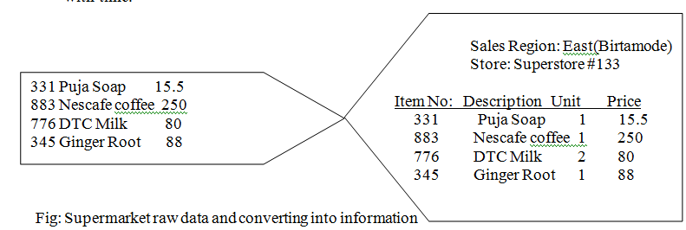
Data versus information

Slide 5
Characteristics of information
Subjectivity:
The value and usefulness of information are highly subjective because what is information for one person may not be for another. For example even small change in the price of share of company may influence buying and selling shareholder, however to none-shareholder person a share price of may be just a number with little or no meaning.
Relevance:
Information is good only if it is relevant that is meaningful to decision maker. For example a plant manager is trying to determine why a certain machine breaks down frequently. For that plant manager, the number of units that the machine has produced in the last 5 years is probably not relevant to the problem at hand.
Timeliness
Information must be delivered at the right time and the right place to the right person. In the above example, if the manager gets information about the causes of machine failure a years after requesting it. The information is not timely and hence probably not used.

Slide 6
Characteristics of information
Accuracy
Information must be free of errors because erroneous information results in poor decisions and erode the confidence of users. For example great precision is not required in predicting the number of customers at restaurant but is critical for calculating salary of person.
Correct information format
Information must be in the right format to be useful to the decision maker. If manager wants to know the total sales of product A last years, the most appropriate format is an annual summary of sales figure for that product. The format should be such that it can be applied directly to the problem hand without further processing.
Completeness
Information is said to be complete if the decision maker can satisfy solve the problem at hand using that information. Although the completeness of information is highly desirable, often complete information is not available. Managers are compelled to make decision even when their information is in complete.

Slide 7
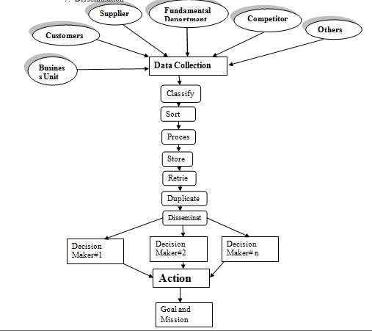
The process of converting data into information

Slide 8
Introduction to information System
An information system can be defined technically as a set of interrelated components that collect or retrieve, process, store and distribute information to support decision making and control in an organization.
In addition to supporting decision making, coordination and control, information system may also help managers and workers analyze problem visualization complex subjects, and create new products.
A system that creates, processes, stores, and retrieves information. The input such a system is data; processed data become information. It facilitate organizational decision making. Information system is guided by set of policies, principles, procedure, and resources. Various social, technical and environmental factors influence the design and development of such system.

Slide 9
Introduction to information System
Resources of Information System:
1. Hardware:
The system components which can physically touch
2. Software:
Collection of program and documentation to perform specific task.
3. People: end user, technical person, System administrator.
4. Data:
Any fact and figure:
5.Network:
Interconnectivity of computer

Slide 10
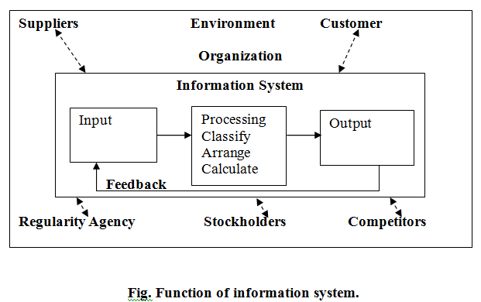
Function of Information System

Slide 11
Introduction to information System
An information system contains information about organizations and its surrounding environment. Three basic activities; input, processing, output produce the information organization need. Feedback is output returned appropriate people or activities in the organization to evaluate and refine the input environmental factors such as customers, suppliers, competitors, stockholders, and regulatory agencies interact with the organization and its information.
Input: It is used to capture or collects raw data from within the organization of from its external environments for processing in an information system.
Processing: The conversion, manipulation and analysis of raw input into a form that is more meaningful to humans.
Output: The distribution of processed information to the people who will use it or to the activities for which it will be used.
Feedback: Output that is returned to appropriate members of the organization to help them evaluate or correct input.

Slide 12
Management Information System
Management information system is the study of information and impact on the individual, the organization, and society also, systems that create, process, store, and retrieve information.
A system is a collection of parts that work together to achieve a common goal. The primary goal of MIS is to support organizational decision making. It is well-integrated system that meet tactical information needs of middle managers.
These system generate summary report. MIS serve the management level of the organization that serve the function of planning, controlling and decision making by providing routine summary.

Slide 13
TYPES OF INFORMATION SYSTEMS
Transaction processing System(TPS):
A transaction processing system is a computerized system that performs and records the daily routine transactions necessary to conduct business, such as sales order entry, hotel reservations, payroll, employee record keeping, and shipping.
Characteristic of transaction processing system:
A TPS records internal and external transaction for a company. It is repository of data that is frequently accessed by other system.
A TPS performs routine, repetitive tasks. It is mostly used by lower level manager to make operational decisions.
Transaction can be recorded in batch mode or online. In batch mode, the files are updated automatically at later time; in online , transaction is recorded at it occurs.
There are six steps involve in processing a transaction. They are data entry, data validation, data processing and revalidation, storage, output generation, and query support.

Slide 14
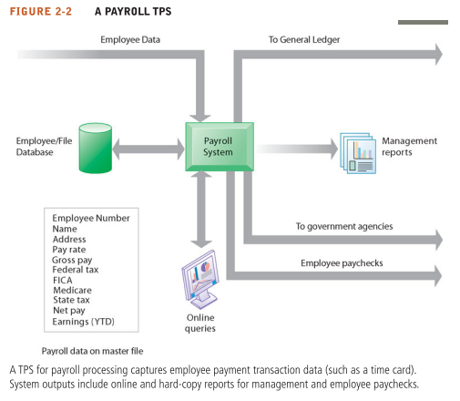
TYPES OF INFORMATION SYSTEMS
Transaction processing System(TPS):

Slide 15
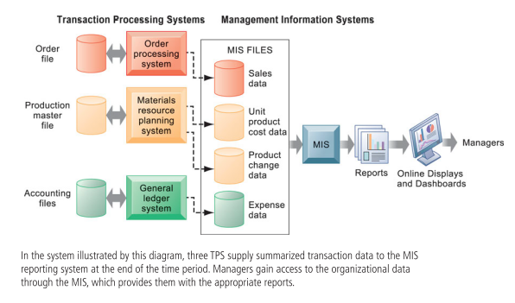
TYPES OF INFORMATION SYSTEMS
Management information systems (MIS)

Slide 16
TYPES OF INFORMATION SYSTEMS
Management information systems (MIS)
It a specific category of information systems serving middle management. MIS provide middle managers with reports on the organization’s current performance. This information is used to monitor and control the business and predict future performance.
MIS summarize and report on the company’s basic operations using data supplied by transaction processing systems. The basic transaction data from TPS are compressed and usually presented in reports that are produced on a regular schedule.
Difference between a TPS and an MIS:
The primary goal of a TPS is to record and process transaction that take place in the company, while the primary goal of an MIS is to produce summary and exception reports used in tactical decision making. Second, the output of a TPS becomes the input to an MIS, and although the TPS is not the only source of data to the MIS, it is primary sources. The above figure shows that transaction data are input into a TPS and that the output of a TPS becomes the input to an MIS. Finally, a TPS helps managers primarily with operational or day to day decisions, while an MIS helps managers make tactical decisions over a longer period of time, such as weekly, monthly, and yearly.

Slide 17
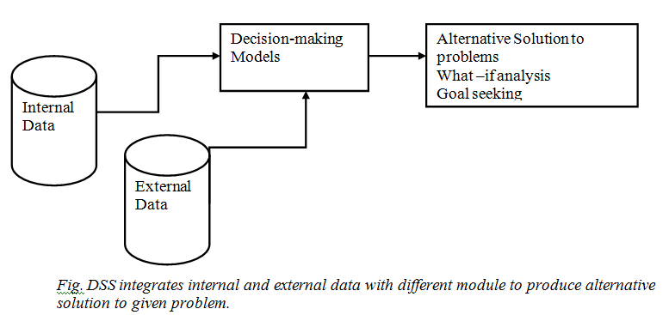
TYPES OF INFORMATION SYSTEMS
Decision-Support Systems (DSS) A set of well integrated, user friendly, computer-based tools that combine internal and external data with various decision making models to solve semi-structured and unstructured problems. Among the functions of a DSS are “What if” analysis, model building, goal seeking, and graphical analysis.

Slide 18
TYPES OF INFORMATION SYSTEMS
Decision-Support Systems (DSS) A set of well integrated, user friendly, computer-based tools that combine internal and external data with various decision making models to solve semi-structured and unstructured problems. Among the functions of a DSS are “What if” analysis, model building, goal seeking, and graphical analysis.
A DSS can present a manager with different pricing alternative and help answer “What if” Question such as these: what if the price of raw materials increases by 4.5% a years? What if demand for a product increase by 10%? What if a competitor reduces its price for a similar product by 20%.
A DSS also allows managers to perform goal-seeking, which specifies the actions a manager should take in order to accomplish a certain goal. For example suppose the goal of the company is to increase sales of product A by 10%. A DSS can help a marketing manager decide on the course of action to take regarding operation costs, product pricing, advertising, and other related issues in order to achieve the goal.

Slide 19
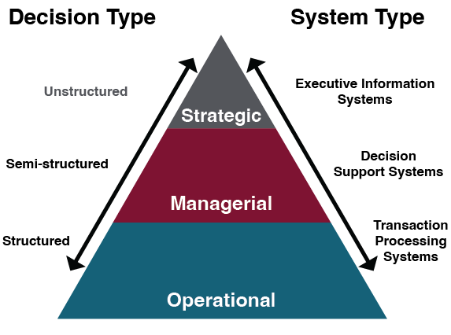
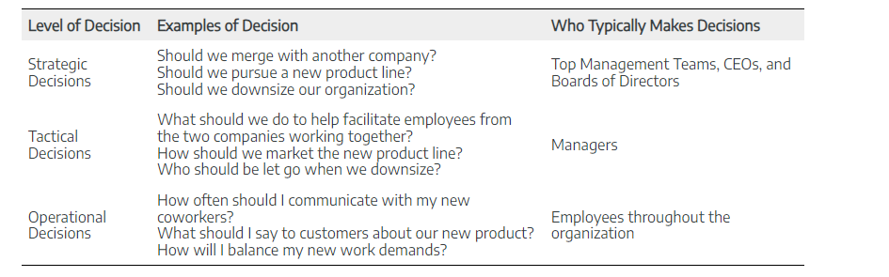
Notes:
A semi-structured decision is one in which most of the factors needed for making the decision are known but human experience and other outside factors may still impact the decision. A good example of a semi-structured decision is the hiring process.
A structured decision is one that is made quite often, and one in which the decision is based directly on the inputs.
In contrast, an unstructured decision or non programmed decision involves a lot of unknowns. They are generally based on criteria that are not well-defined, and information is more likely to be ambiguous or incomplete

Slide 20
TYPES OF INFORMATION SYSTEMS
A DSS has the following characteristics:
It facilitates semi-structure and unstructured decision making by bringing together data, models, and human judgment.
It can provide decision support for several interdependent decisions.
It supports a wide variety of decision-making processes and Business intelligence
It assists the decision maker to make decision under dynamic business condition.
It helps the decision maker address ad hoc queries.
Business intelligence is type of software applications used for organizing, analyze current and historical data to find patterns and trends and aid decision-making. It support middle and senior management.
Executive support systems(ESS)
It is primarily used by top level management, is user friendly, interactive system, designed to meet information needs of top management engaged in long-range planning, crisis management, and other strategic decision(unique, non-repetitive and future oriented), which address ling-term issues such as emerging markets, merger and acquisition strategies, new product development and investment strategies. Such system assists in the making of decision that requires an in-depth understanding of the firm and of the industry in which the firm operates.

Slide 21
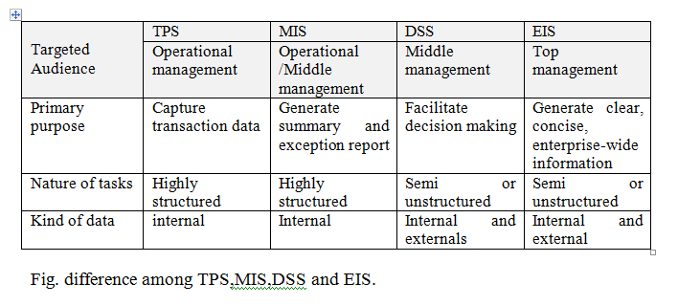
TYPES OF INFORMATION SYSTEMS
Executive support systems(ESS)
Characteristics of an ESS
DSS and EIS have many functions in common, including “what-if ”analysis, goal seeking, risk analysis, and graphical analysis, in addition to these an EIS has two special functions:
Derived-information function:
A function of an EIS that allows mangers to find the cause or source of a certain problem through detailed data analysis. Like a portal, which uses a Web interface to present integrated personalized business content.
The drill-down function:
A function of an EIS that can precisely locate and retrieve necessary information at any desired level of detail like digital dashboard, which displays on a single screen graphs and charts of key performance indicators for managing a company. Digital dashboards are becoming an increasingly popular tool for management decision makers.

Slide 22
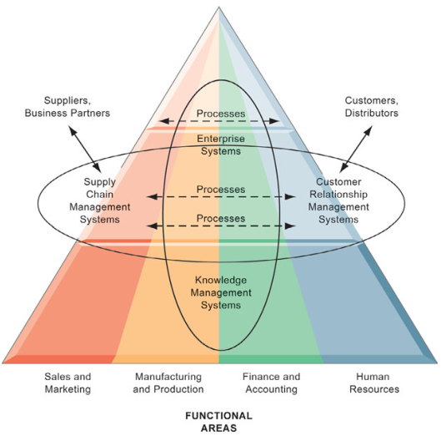
Enterprise resource planning

Slide 23
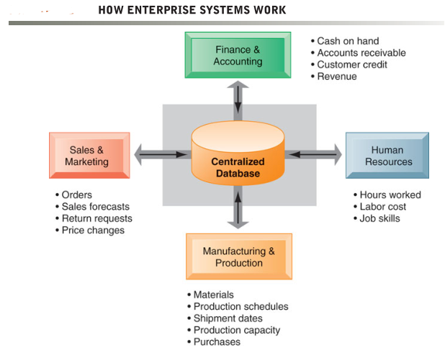
Enterprise resource planning
Enterprise systems feature a set of integrated software modules and a central database that enables data to be shared by many different business processes and functional areas throughout the enterprise.

Slide 24
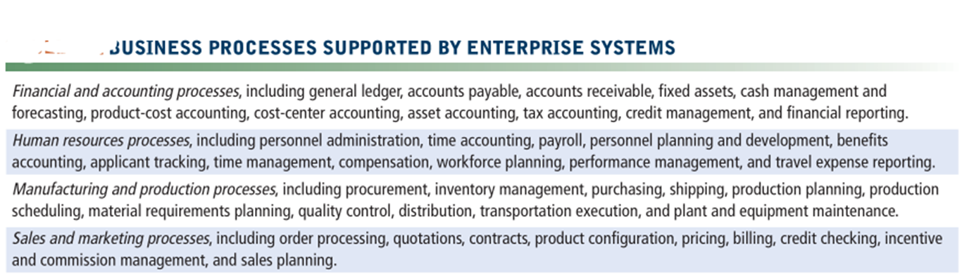
Enterprise resource planning

Slide 25
Enterprise resource planning
Enterprise resource planning,(ERP) is a business system that integrates multiple applications relating to accounting, human resources, inventory, orders, shipping, and services. ERP systems have been widely used since the early 1990s and fall under the umbrella of enterprise applications, as larger businesses often use them.
Today, many ERP systems (ERP suites) run in the cloud as a SaaS (Software as a Service). A cloud ERP makes it easier and more secure for businesses to manage their information. These systems can be maintained by a company who specializes in upkeep on servers and databases, keeping them secure, and can make it easier to scale as your business grows.
For companies that cannot have or do not want their data in the cloud, on- premise ERP can run on a company's data center.
Alternatively, a company can have a hybrid ERP that runs some of their systems in the cloud and other systems on premise.

Slide 26
Enterprise resource planning
For example, when a customer places an order, the order data flow automatically to other parts of the company that are affected by them.
The order transaction triggers the warehouse to pick the ordered products and schedule shipment.
The warehouse informs the factory to restock whatever has been short. The accounting department is notified to send the customer an invoice.
Customer service representatives track the progress of the order through every step to inform customers about the status of their orders.
Managers are able to use firm-wide information to make more precise and timely decisions about daily operations and longer-term planning.

Slide 27
Enterprise resource planning
What are the benefits of ERP Software Systems?
Enterprise systems provide much valuable information for improving management decision making.
Corporate headquarters has access to up-to-the- minute data on sales, inventory, and production and uses this information to create more accurate sales and production forecasts.
Enterprise software includes analytical tools for using data captured by the system to evaluate overall organizational performance.
Enterprise system data have common standardized definitions and formats that are accepted by the entire organization.
Performance figures mean the same thing across the company. Enterprise systems allow senior management to easily find out at any moment how a particular organizational unit is performing, determine which products are most or least profitable, and calculate costs for the company as a whole.

Slide 28
Enterprise resource planning
What are the benefits of ERP Software Systems?
By integrating various facets of the business, it optimizes the efficiency at which you manage your business and immensely contributes to profitability. The following are some of the benefits of ERP software.
we only need one system to manage all our business functions. This will save a lot of money which you would potentially invest in buying multiple software systems, tools, applications etc.
Since it is designed to have a single database, it allows all the users operating at different functions to work faster. Thereby, the efficiency of each function increase.
By automating the various process, it saves a lot of time and efforts involved in managing the business process and computing it.
All the reports and statements are system generated
Gives a complete view of the business and insights for confident business decisions.

Slide 29
Supply chain management (SCM) systems
Supply chain management (SCM) systems:
It help manage relationships with their suppliers. These systems help suppliers, purchasing firms, distributors, and logistics companies share information about orders, production, inventory levels, and delivery of products and services so that they can source, produce, and deliver goods and services efficiently.
The ultimate objective is to get the right amount of their products from their source to their point of consumption in the least amount of time and at the lowest cost.
These systems increase firm profitability by lowering the costs of moving and making products and by enabling managers to make better decisions about how to organize and schedule sourcing, production, and distribution.

Slide 30
Supply chain management (SCM) systems
Supply chain management (SCM) systems:
A firm’s supply chain is a network of organizations and business processes for procuring raw materials, transforming these materials into intermediate and finished products, and distributing the finished products to customers.
It links suppliers, manufacturing plants, distribution centers, retail outlets, and customers to supply goods and services from source through consumption.
Materials, information, and payments flow through the supply chain in both directions Goods start out as raw materials and, as they move through the supply chain, are transformed into intermediate products (also referred to as components or parts), and finally, into finished products.
The finished products are shipped to distribution centers and from there to retailers and customers. Returned items flow in the reverse direction from the buyer back to the seller.

Slide 31
Supply chain management (SCM) systems
Supply chain management (SCM) systems:
inefficiencies in the supply chain, such as parts shortages, underutilized plant capacity, excessive finished goods inventory, or high transportation costs, are caused by inaccurate or untimely information.
For example, manufacturers may keep too many parts in inventory because they do not know exactly when they will receive their next shipments from their suppliers. Suppliers may order too few raw materials because they do not have precise information on demand. These supply chain inefficiencies waste as much as 25 percent of a company’s operating costs.
If a manufacturer had perfect information about exactly how many units of product customers wanted, when they wanted them, and when they could be produced, it would be possible to implement a highly efficient just-in-time strategy. Components would arrive exactly at the moment they were needed and finished goods would be shipped as they left the assembly line.

Slide 32
Supply chain management (SCM) systems
Major task of SCM:
Decide when and what to produce, store, and move
Rapidly communicate orders
Track the status of orders
Check inventory availability and monitor inventory levels
Reduce inventory, transportation, and warehousing costs
Track shipments
Plan production based on actual customer demand
Rapidly communicate changes in product design

Slide 33
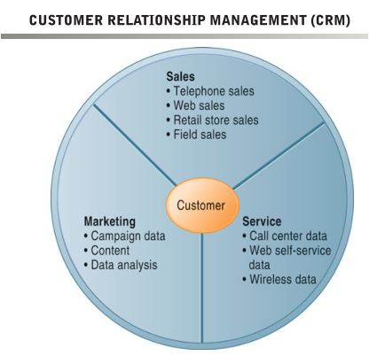
Customer relationship management(CRM)
Customer relationship management(CRM) systems: it help to manage their relationships with their customers. CRM systems provide information to coordinate all of the business processes that deal with customers in sales, marketing, and service to optimize revenue, customer satisfaction, and customer retention.
This information helps firms identify, attract, and retain the most profitable customers; provide better service to existing customers; and increase sales systems:
CRM systems examine customers from a multifaceted perspective. These systems use a set of integrated applications to address all aspects of the customer relationship, including customer services, sales, and marketing.

Slide 34
Customer relationship management(CRM)
Benefits:
Companies with effective customer relationship management systems realize many benefits, including increased customer satisfaction, reduced direct marketing costs, more effective marketing, and lower costs for customer acquisition and retention.
Information from CRM systems increases sales revenue by identifying the most profitable customers and segments for focused marketing and cross-selling.
Customer churn is reduced as sales, service, and marketing better respond to
customer needs.
The churn rate measures the number of customers who stop using or purchasing products or services from a company.
It is an important indicator of the growth or decline of a firm’s customer base.
Notes:
Churn decresing rate

Slide 35
Knowledge management systems (KMS):
Knowledge management systems (KMS):
It enables organizations to better manage processes for capturing and applying knowledge and expertise. These systems collect all relevant knowledge and experience in the firm, and make it available wherever and whenever it is needed to improve business processes and management decisions. They also link the firm to external sources of knowledge.

Slide 36
Challenges of Enterprise Systems Implementations
Challenges in implementing ERP solutions are quite normal. Though it is not completely a technical job, a lot of planning and proper communication is very much essential to implement ERP across the organization.
It is very important, that implementation is done in stages. Trying to implement everything at once will lead to a lot of confusion and chaos.
Appropriate training is very essential during and after the implementation. The staff should be comfortable in using the application or else, it will backfire, with redundant work and functional inefficiencies.
Lack of proper analysis of requirements will lead to non-availability of certain essential functionalities. This might affect the operations in the long run and reduce the productivity and profitability.
Lack of Support from Senior Management will lead to unnecessary frustrations in work place. Also, it will cause delay in operations and ineffective decisions. So, it is essential to ensure that the Senior Management supports the transformation.

Slide 37
Challenges of Enterprise Systems Implementations
5. Compatibility Issues with ERP Modules lead to issues in integration of modules. Companies associate different vendors to implement different ERP modules, based on their competency. It is very essential that there is a way to handle compatibility issues.
6. Cost Overheads will result, if requirements are not properly discussed and decided during the planning phase. So, before execution, a detailed plan with a complete breakdown of requirements should be worked out.
7. Investment in Infrastructure is very essential. ERP applications modules will require good processing speed and adequate storage. Not allocating suitable budget for infrastructure will result in reduced application speed and other software issues. Hardware and Software Security is also equally important.

Slide 38
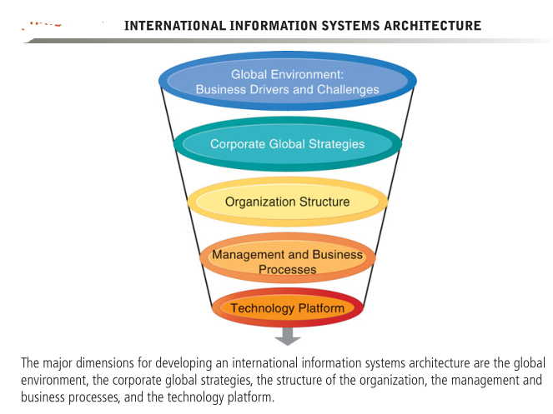
International Information Systems-Outsourcing and off-shoring

Slide 39
International Information Systems-Outsourcing and off-shoring
International information systems: This model is characterized by a computer network that operates in more than one nation-state and in which data cross international borders in the process of completing a transaction. This model is now increasingly based on the Internet as its medium of data transfer.
Outsourcing refers to an organization contracting work out to a 3rd party, while offshoring refers to getting work done in a different country, usually to leverage cost advantages.
It's possible to outsource work but not offshore it; for example, hiring an outside law firm to review contracts instead of maintaining an in-house staff of lawyers. It is also possible to offshore work but not outsource it; for example, a Dell customer service center in India to serve American clients.
Offshore outsourcing is the practice of hiring a vendor to do the work offshore, usually to lower costs and take advantage of the vendor's expertise, economies of scale, and large and scalable labor pool.

Slide 40
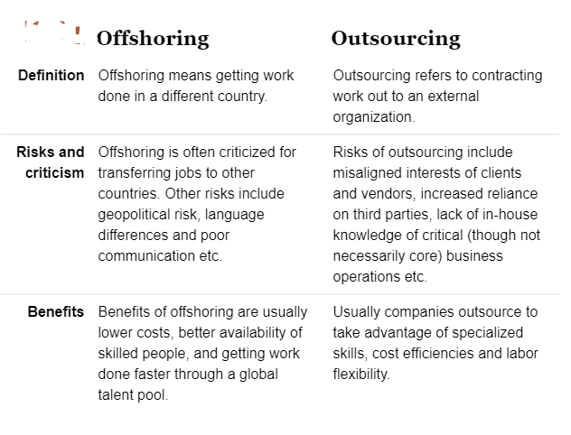
International Information Systems-Outsourcing and off-shoring

Slide 41
Assignment
1. Explain data, information and information system with example.
2. Why information is important? Explain the characteristics information with example.
3. Explain Management information system and its usage in the organization.
4. Explain Transaction processing System with its major characteristics.
5. How does DSS add value for organization explain with proper example?
6. Comparatively differences among TPS, MIS, DSS, ESS.
7. How do enterprise systems help businesses achieve operational excellence?
8. How do supply chain management systems coordinate planning, production, and logistics with suppliers?
9. How do customer relationship management systems help firms achieve customer intimacy?
What types of companies are most likely to adopt cloud-based ERP and CRM software services? Why?
What companies might not be well-suited for this type of software?
11. What are the challenges posed by enterprise applications?
12. List and describe the challenges posed by enterprise applications.
13. Explain how these challenges can be addressed
14. Which enterprise application should a business install first: ERP, SCM, or CRM? Explain your answer.

